Slide 1




GURU GHASIDAS UNIVERSITY KONI, BILASPUR
Department of Computer Science & Information Technology
2022-23
MINOR PROJECT WORK
PROJECT - COMPUTER VIRUS
PROJECT BY- UMESH KUMAR SHRIWAS
ROLL NO.- 20207063
GUIDED BY - DR. VIKAS PANDEY
CLASS - B.Sc C.S. 6th Semester
ENROLL NO.- GGV/20/05163
Notes:
GUIDED BY - DR. VIKAS PANDEY

Slide 2



Session 2022-23
SUBMITTED BY - UMESH KUMAR SHRIWAS
ROLL NO. - 20207063
CLASS - B.Sc C.S. 6th Semester
ENROLL NO. - GGV/20/05163
UNDER THE GUIDANCE OF ->
DR. VIKAS PANDEY
SUBMITTED TO ->
DR. A.K. SAXENA
(ASSISTANT PROFESSOR CSIT)
( HOD OF CSIT DEPARTMENT )
Notes:
Session 2022-23
UNDER THE GUIDANCE OF
DR. VIKAS PANDEY
(ASSISTANT PROFESSOR CSIT)
SUBMITTED TO
DR. A.K SAXENA
(HOD DEPARTMENT OF CSIT)

Slide 3
D E C L A R A T I O N
In this undersigned project I solemnly declare that the report of the project work entitled “library management System”is
the actual work carried out during the course of my study under the supervision of
DR VIKAS PANDEY
Department of computer science
We assert that the statements made and conclusions drawn are an outcome of the project work. I further declare that to the
best of my knowledge and belief that the report does not contain any part of any work which has been submitted for the
award of any other degree/diploma/certificate in this University/deemed University of India or any other country. All help
received used for the preparation of the project have been duly acknowledged.
(Signature of the Candidate)
NAME : UMESH KUMAR SHRIWAS
Roll No. : 20207063
Enrolment No. : GGV/20/05163
Notes:
DR VIKAS PANDEY

Slide 4

C E R T I F I C A T E
The project entitled "COMPUTER VIRUS"
Submitted by UMESH KUMAR SHRIWAS
(Roll No.: 20207058)
has been Examined by the undersigned as a part of the
Examination.
Signature of Project Guide
Signature of HOD

Slide 5
A C K N O W L E D G E M E N T
It is great pleasure for me to present my project report on
"COMPUTER VIRUS”
To the department of
COMPUTER SCIENCE & INFORMATION TECHNOLOGY (CSIT)
I also express my sincere thanks to the
HOD of COMPUTER SCIENCE & INFORMATION TECHNOLOGY (CSIT)
For providing us with the relevant facilities. I would like to thank the management for giving support throughout the project work. I am also grateful to all those who directly or indirectly helped me in the successful completion of this project report.
(Signature of the Candidate)
Name : UMESH KUMAR SHRIWAS
Roll No. : 20207063
Enrolment No. : GGV/20/05163

Slide 6
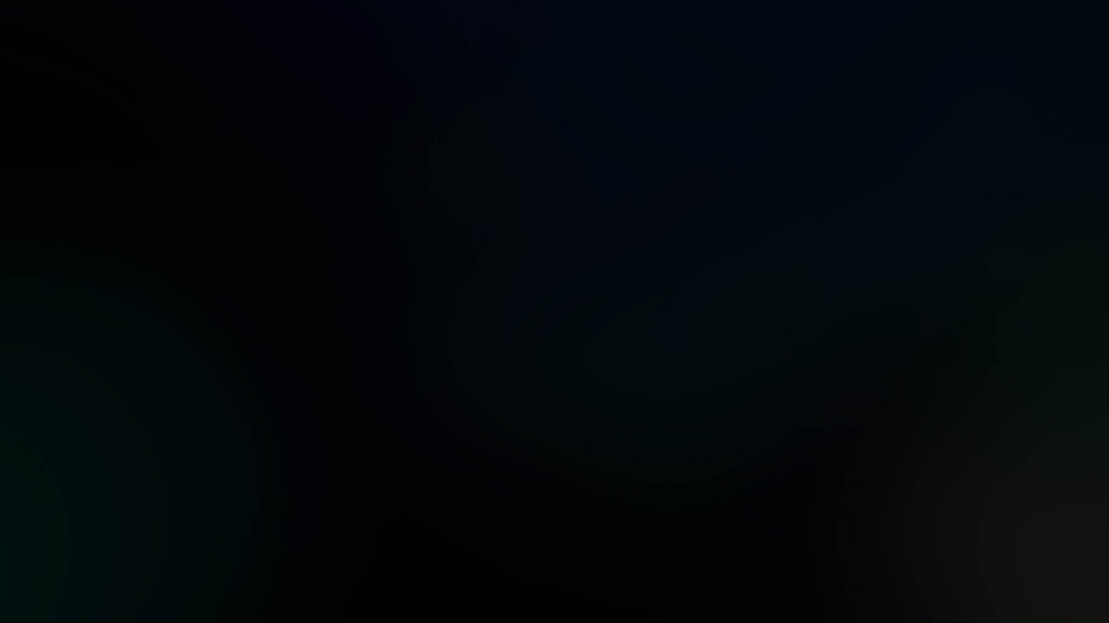
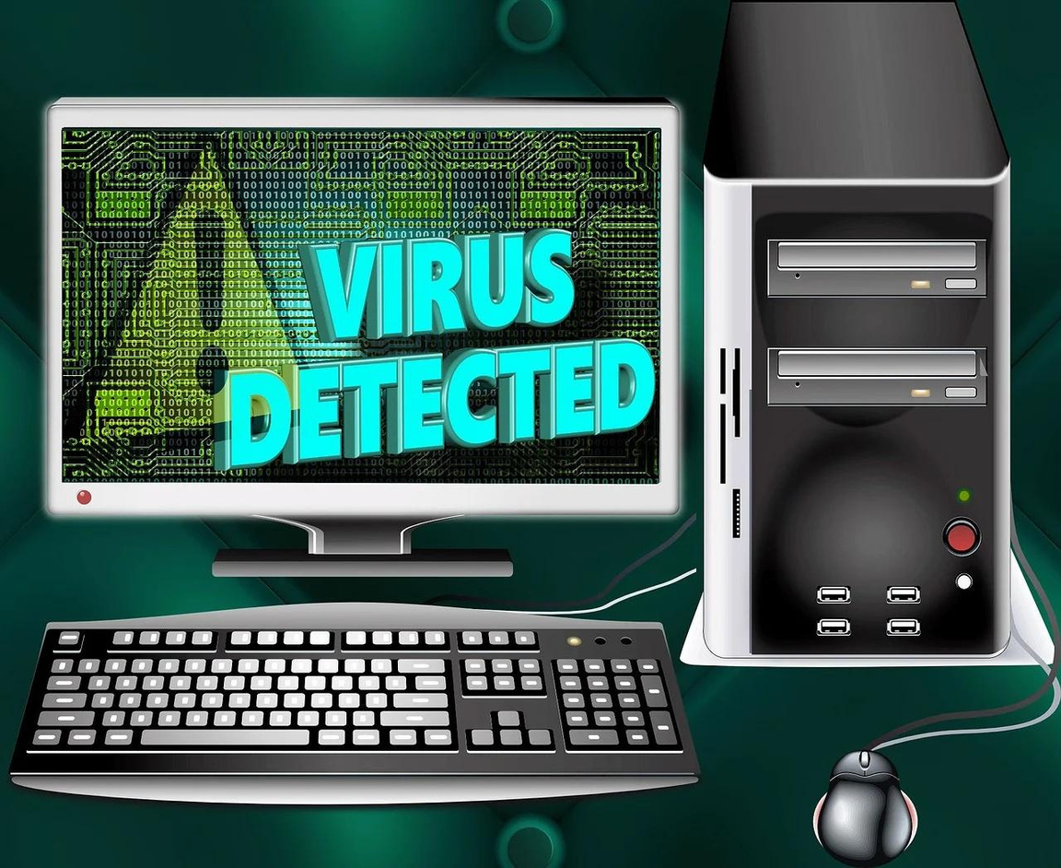

'COMPUTER VIRUS'
Notes:
COMPUTER VIRUS

Slide 7
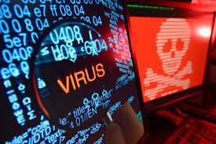
WHAT IS COMPUTER VIRUS ?->
A computer virus is a type of malware that attaches itself to other programs, self-replicates, and spreads from one computer to another. When a virus infects a computer, it makes copies of itself and attaches to other files or documents. It then modifies those files and continues to spread.
Notes:
A computer virus is a type of malware that attaches itself to other programs, self-replicates, and spreads from one computer to another. When a virus infects a computer, it makes copies of itself and attaches to other files or documents. It then modifies those files and continues to spread

Slide 8

VIRUS TYPES
The nine major categories for viruses on computers are:
Boot Sector Virus
Web Scripting Virus
Browser Hijacker
Resident Virus
Direct Action Virus
Polymorphic Virus
File Infector Virus
Multipartite Virus
Macro Virus
Notes:
VIRUS TYPES

Slide 9
How Do Viruses Spread?
Computer viruses spread through various channels, and being aware of these channels is essential to protect yourself and your organization from infection
Email Attachments
Internet Downloads
File Sharing Networks
Removable Media

Slide 10
Examples of Computer Virus ->
Morris Worm - One of the earliest and most pervasive computer virus, slowing down or crashing many machines.
Nimda – This particular type of worm targeted web servers and computers running Microsoft Windows operating systems,
ILOVEYOU – A highly destructive worm that spread via email, disguised as a love confession and caused widespread damage in 2000 by overwriting files.
SQL Slammer – A fast-spreading computer worm that exploited a vulnerability in Microsoft SQL Server.
CryptoLocker – This ransomware Trojan, which infected hundreds of thousands of computers in 2013, encrypted victims’ files and demanded a ransom for their decryption
Shlayer – A macOS-specific Trojan that primarily spreads through fake software updates and downloads, delivering adware and potentially unwanted programs since 2018.

Slide 11
How to Remove a Computer Virus ->
Download and install antivirus software: Assuming you don’t already have antivirus software installed, download and install a real-time and on-demand solution, if possible. A real-time malware scanner scans for viruses in the background while you use the computer. You must start the on-demand scanner whenever you want to scan your device.
Disconnect from the internet: Some computer viruses use the internet connection to spread, so it’s best to disconnect from the internet when removing a virus from your PC to prevent further damage.
Delete any temporary files: Depending on the type of virus, deleting temporary files can also delete the virus, as some viruses are designed to initiate when your computer boots up.
Reboot your computer into safe mode: To help mitigate damages to your computer while you remove a virus, reboot your device in ‘Safe Mode.’ This will inhibit the virus from running and allow you to remove it more effectively.
Run a virus scan: Run a full scan using your antivirus software, opting for the most thorough or complete scanning option available. If possible, cover all your hard drive letters during the scan.
Update your browser and operating system: To complete the virus removal process, update your operating system and web browser to the latest version possible. Browser and OS Updates often contain fixes for particular vulnerabilities and exploits

Slide 12

INTRODUCTION
It is a harmless virus developed in Java.
When this virus runs in any system, many pop up windows are displayed on the screen.
It also disturbs your mouse cursor and keyboard, during running of this virus your mouse cursor makes random movement and keyboard stops working.
This virus does not harm your computer until you run it in an infinite loop.
Notes:
It is a harmless virus developed in Java.
When this virus runs in any system, many pop up windows are displayed on the screen. It also disturbs your mouse cursor and keyboard, during running of this virus your mouse cursor makes random movement and keyboard stops working. This virus does not harm your computer until you run it in an infinite loop.

Slide 13
Signs
Frequent pop-up windows.
Changes to your homepage.
Mass emails being sent from your email account.
Frequent crashes.
Unusually slow computer performance.
Unknown programs that start up when you turn on your computer.
Unusual activities like password changes.
Notes:
characteristics

Slide 14
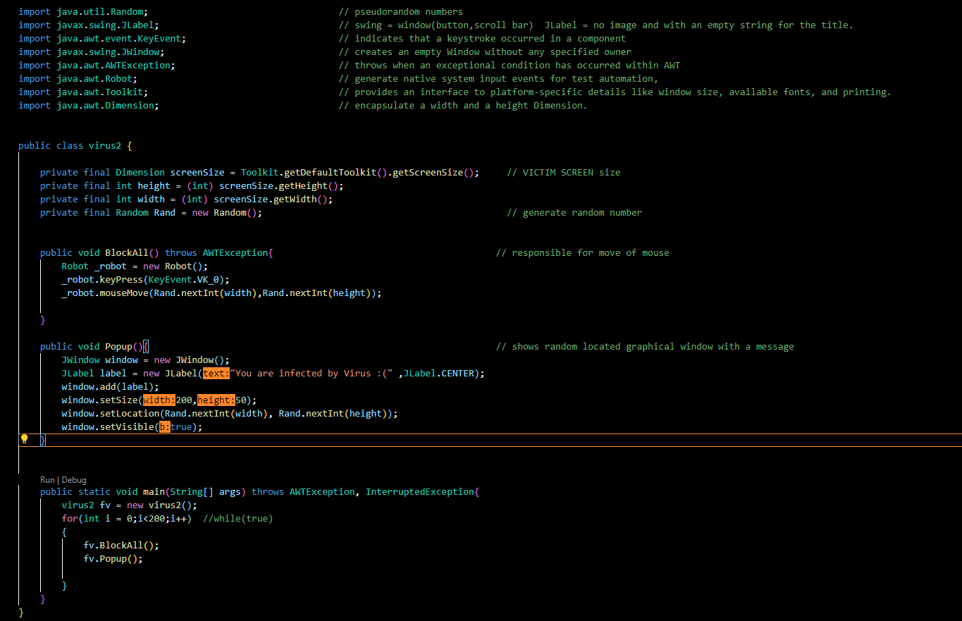
CODE
Notes:
CODE

Slide 15
Java Packages
import java.util.Random | // pseudo random numbers
import javax.swing.JLabel | // swing = window(button,scroll bar) JLabel = no image and with an empty string for the title.
import java.awt.event.KeyEvent | // indicates that a keystroke occurred in a component
import javax.swing.JWindow | // creates an empty Window without any specified owner
import java.awt.AWTException | // throws when an exceptional condition has occurred within AWT
import java.awt.Robot | // generate native system input events for test automation,
import java.awt.Toolkit | // provides an interface to platform-specific details like window size, available fonts, and printing.
import java.awt.Dimension | // encapsulate a width and a height Dimension.
Notes:
Java Packages

Slide 16
FUNCTIONS
getDefaultToolkit()-> The getDefaultToolkit() method returns the system's default Toolkit object. The default Toolkit is identified by the System property awt.toolkit, which defaults to an instance of the sun.
getScreenSize()-> Once you have the screen size as a Java Dimension object, you can get the height and width as follows: // the screen height screenSize. getHeight(); // the screen width screenSize.
get Height() -> return the height of the applet.
setSize() -> The setSize() method is used to set the size of vector.
getWidth() -> return the width of the applet.
setLocation -> Changes the point to have the specificed location.
setVisible() -> The setVisible(true) method makes the frame appear on the screen.
BlockAll() -> Responsible for move of mouse.
Popup() ->shows random located graphical window with a message.
Notes:
getScreenSize(); Once you have the screen size as a Java Dimension object, you can get the height and width as follows: // the screen height screenSize. getHeight(); // the screen width screenSize.

Slide 17
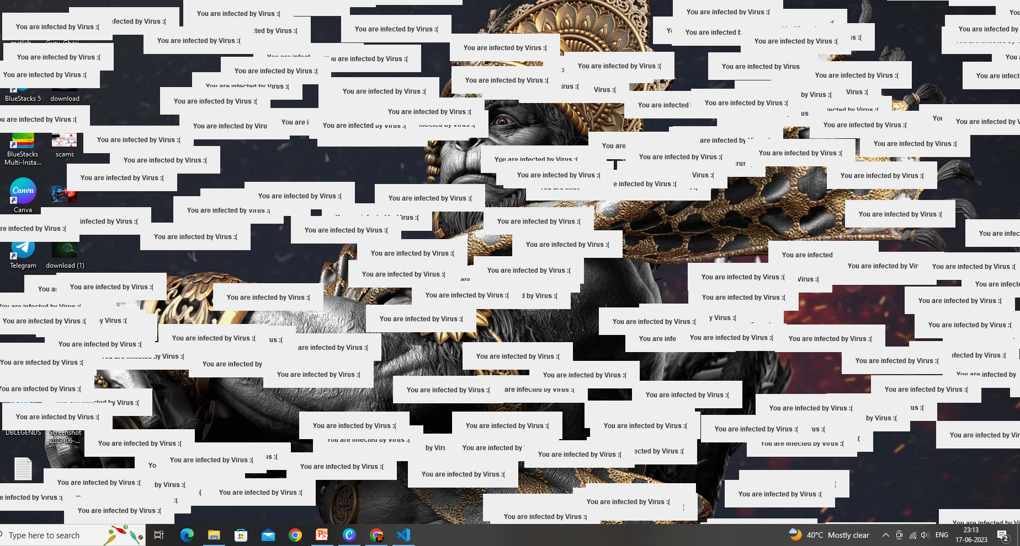
WORKING
SCREENSHOT OF ITS WORKING.
Notes:
SCREENSHOT OF ITS WORKING

Slide 18
USE
To spy on someone by their system and mobile.
In data breaching.
To get unauthorized access of any system.
Use in Hacking.
To crash any system.

Slide 19

FINAL WORD
THIS PROJRCT IS NOT FOR HARM ANY DEVICE OR SYSTEM.THIS VIRUS IS COMPLETELY HARMLESS VIRUS. THIS IS ONLY TO STOP A SYSTEM FUNCTIONING FOR A PARTICULAR TIME PERIOD.
Notes:
CONCLUSION

